Slide 1
Biometric Face Verification via Deep Learning
VENKATA KRISHNA KARTHIK BURRA
16230698

Slide 2
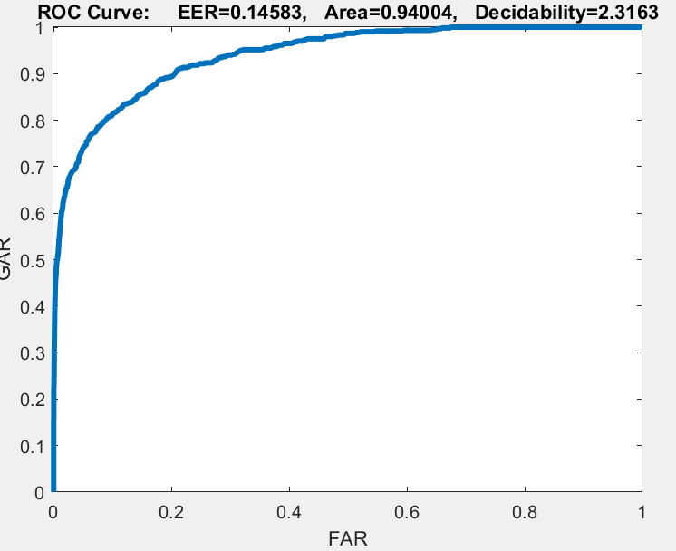
PARTA
Autoencoder1
Hid1=400,
L2W=0.004,
Sparsity regularization= 2
Sparsity Proportion=0.4
Autoencoder2
Hid2=200
L2W=0.004,
Sparsity regularization= 1
Sparsity Proportion=0.25
Ratio=195.8591

Slide 3
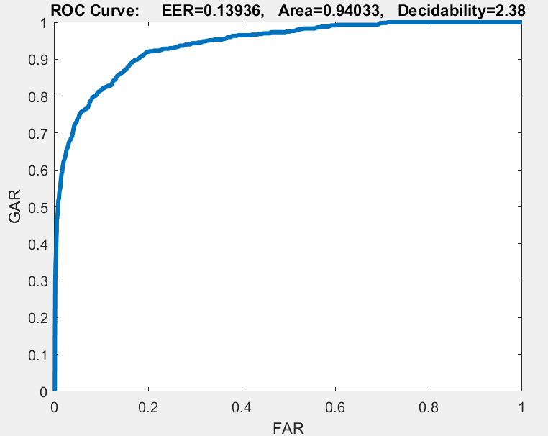
PARTA
Autoencoder1
Hid1=400,
L2W=0.004,
Sparsity regularization= 1
Sparsity Proportion=0.4
Autoencoder2
Hid2=100
L2W=0.004,
Sparsity regularization= 1
Sparsity Proportion=0.25
Ratio=176.83

Slide 4
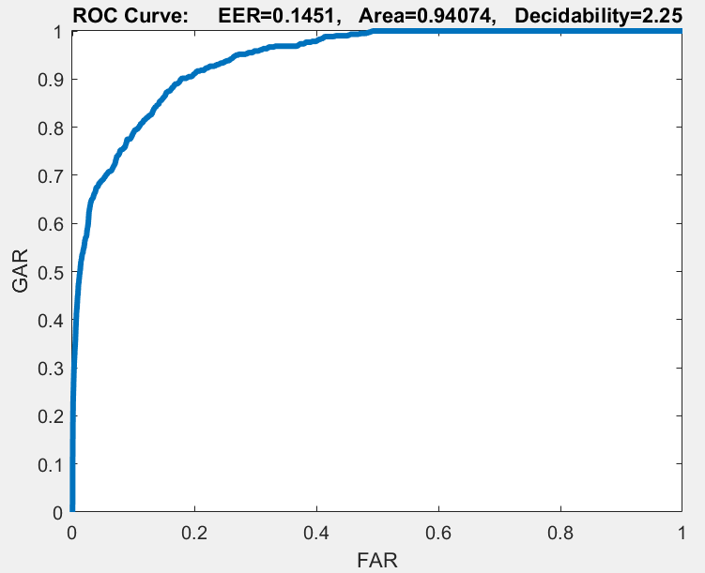
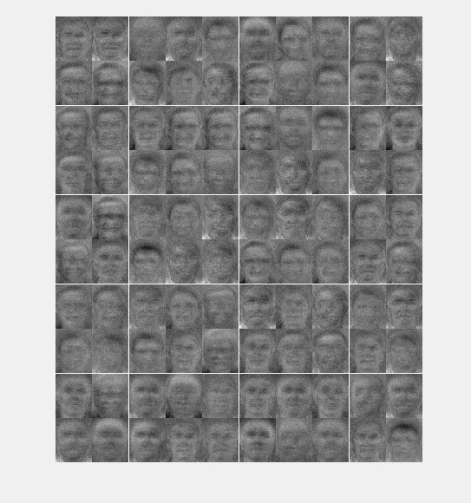
PARTA
Autoencoder1
Hid1=100,
L2W=0.004,
Sparsity regularization= 2
Sparsity Proportion=0.25
Autoencoder2
Hid2=100
L2W=0.004,
Sparsity regularization= 2
Sparsity Proportion=0.25
Ratio=249.97

Slide 5
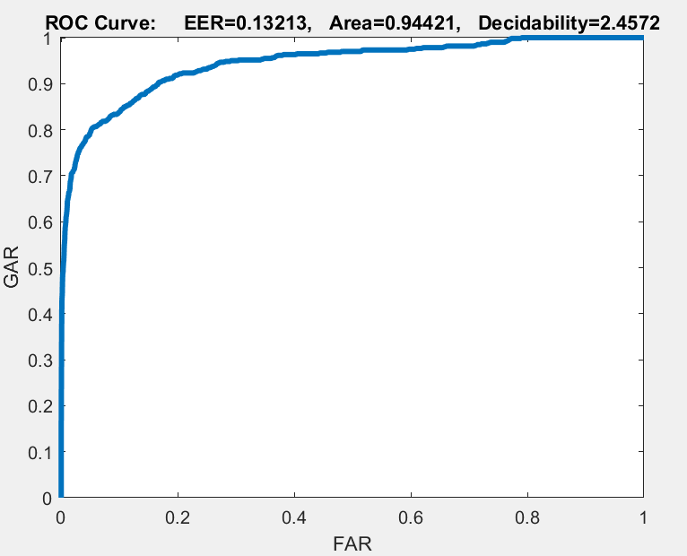
PART A
Autoencoder1
Hid1=300,
L2W=0.004,
Sparsity regularization= 1
Sparsity Proportion=0.4
Autoencoder2
Hid2=200
L2W=0.004,
Sparsity regularization= 1
Sparsity Proportion=0.25
Ratio=175.004

Slide 6
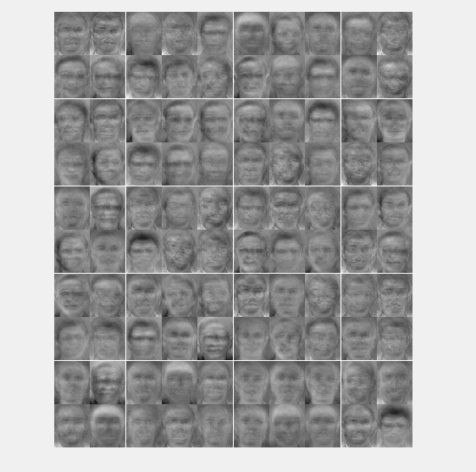
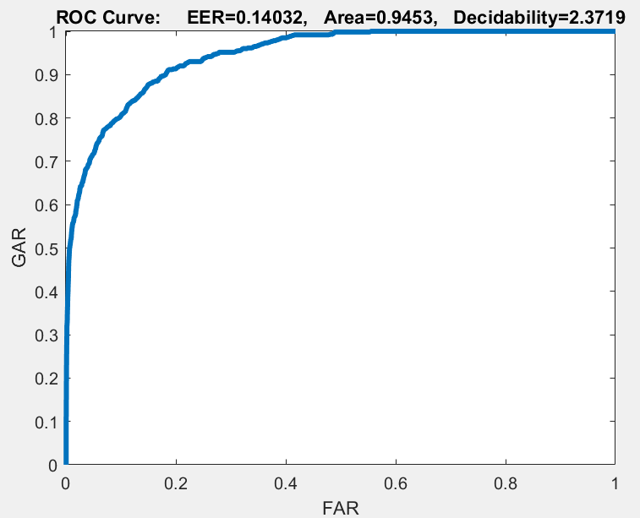
PART A
Autoencoder1
Hid1=200
L2W=0.004,
Sparsity regularization= 1
Sparsity Proportion=0.25
Autoencoder2
Hid2=100
L2W=0.004,
Sparsity regularization= 1
Sparsity Proportion=0.25
ratio=168.0032

Slide 7
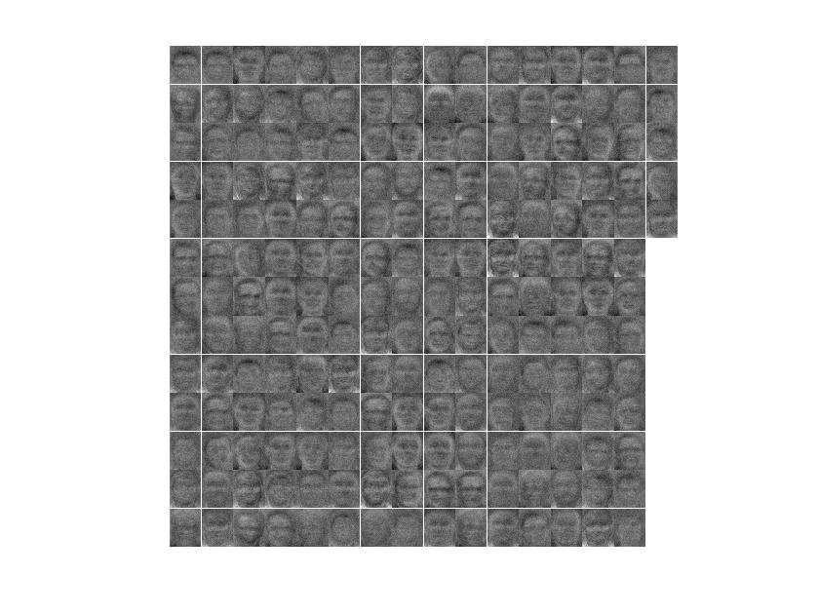
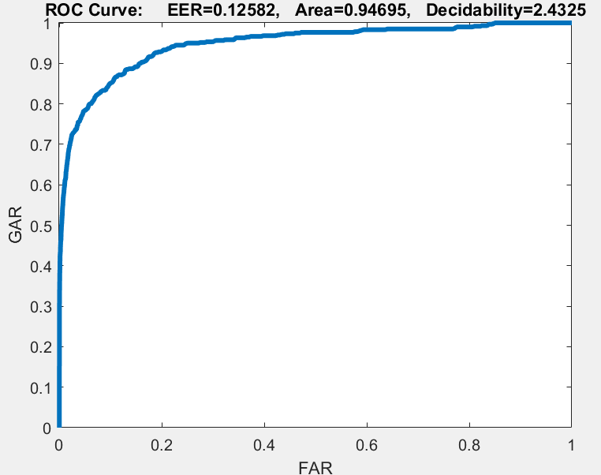
PARTA
Autoencoder1
Hid1=200
L2W=0.004,
Sparsity regularization= 1
Sparsity Proportion=0.5
Autoencoder2
Hid2=100
L2W=0.004,
Sparsity regularization= 1
Sparsity Proportion=0.5
Ratio=189.625

Slide 8
PART A
Hidden Layer Size1 | Hidden Layer Sizes2 | L2W Regularization | Sparsity Regularization (for both autoencoders) | Sparsity Proportion (for both autoencoders) | AUC’s | Ratio
100 | 100 | 0.004 | 2,2 | 0.25,0.25 | 0.94074 | 249.97
200 | 100 | 0.004 | 1,1 | 0.5,0.5 | 0.94695 | 189.625
200 | 100 | 0.004 | 1,1 | 0.25,0.25 | 0.9453 | 168.0032
300 | 200 | 0.004 | 1,1 | 0.4,0.25 | 0.94421 | 175.004
400 | 100 | 0.004 | 1,1 | 0.4,0.25 | 0.94033 | 176.83
400 | 200 | 0.004 | 1,1 | 0.4,0.25 | 0.94004 | 195.8591

Slide 9
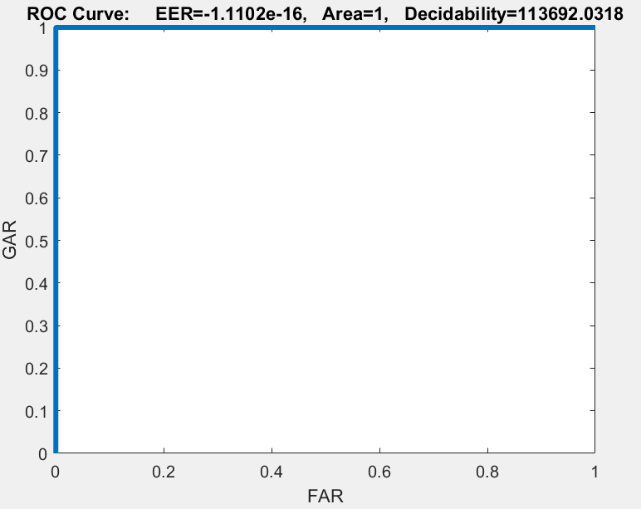
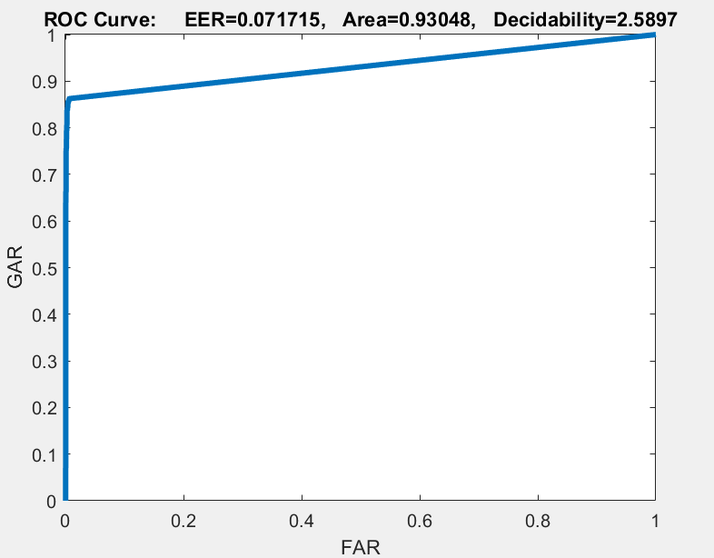
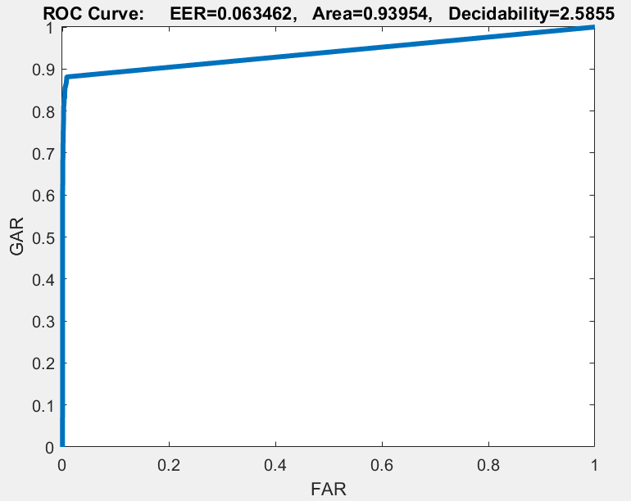
PARTB
Training ROC
40 neural networks
Testing ROC
Testing ROC
After Fine Tuning

Slide 10
Using soft max layer
Hidden Layer size1 | Hidden Layer size2 | Train AUC | Test AUC
200 | 100 | 1 | 0.94667
300 | 100 | 0.9843 | 0.95016
400 | 100 | 1 | 0.97097
400 | 200 | 1 | 0.96724
500 | 200 | 0.9672 | 0.97974
600 | 100 | 1 | 0.95093

Slide 11
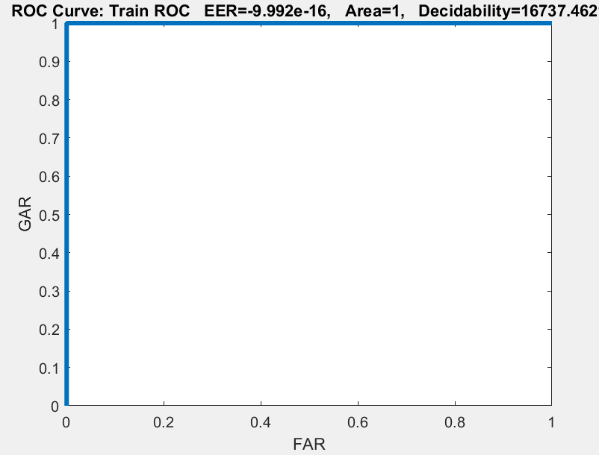
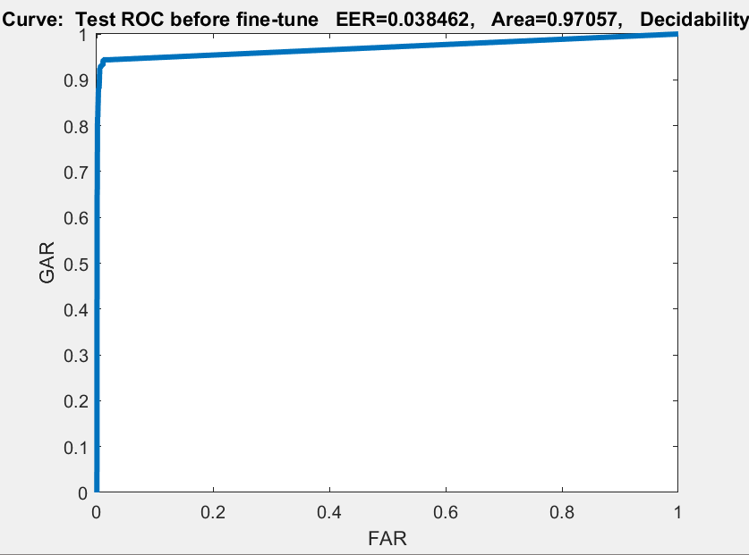
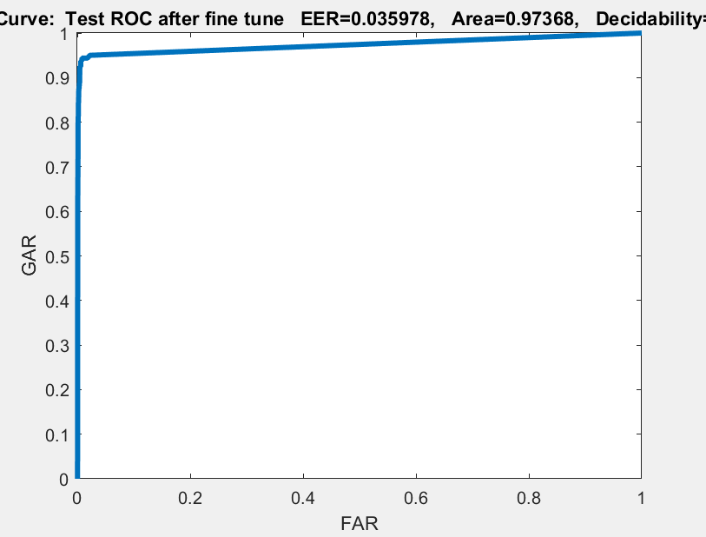
Using soft max layer
Train ROC
H1=400
H2=100
Test ROC
Test ROC after fine-tuning

Slide 12
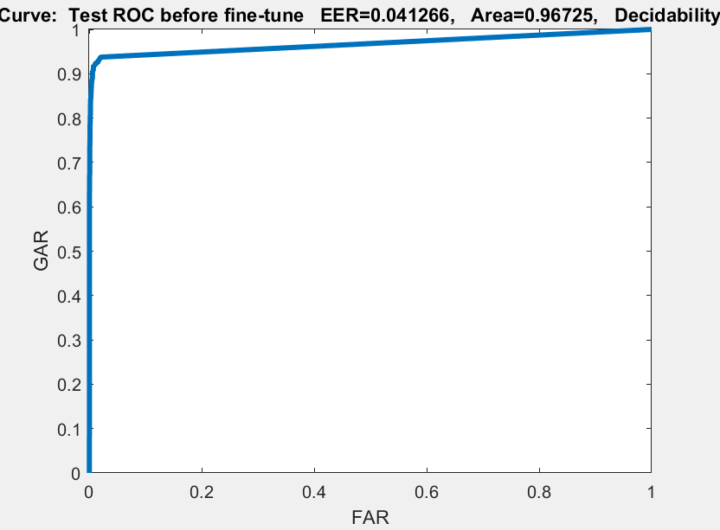
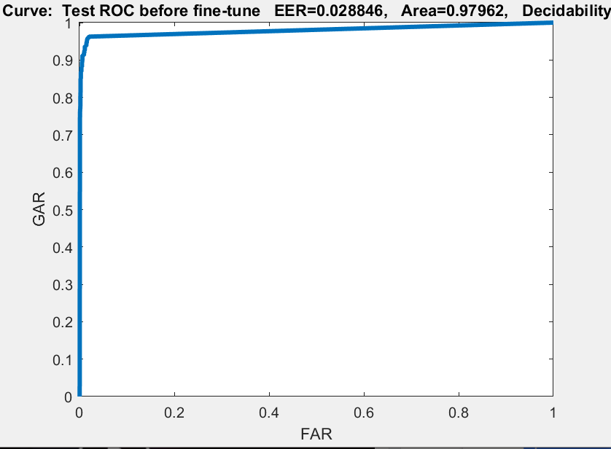
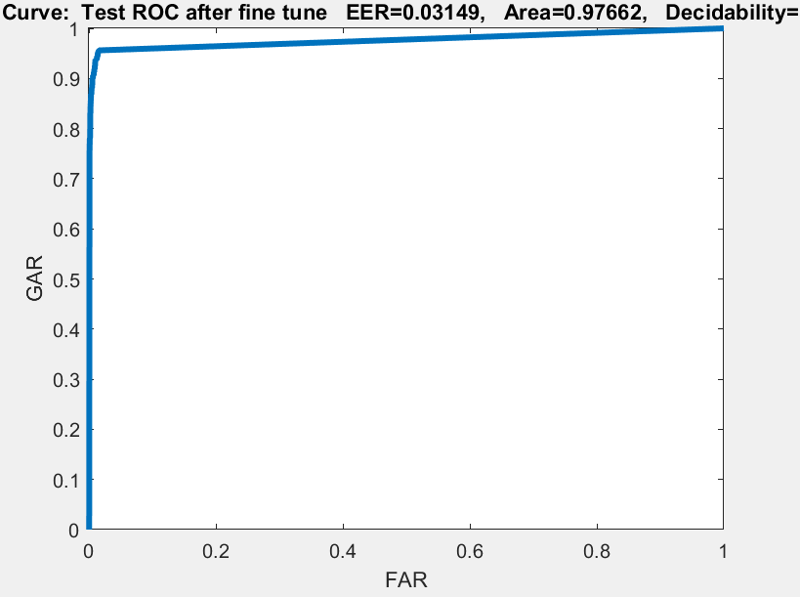
Using soft max layer
Train ROC
H1=500
H2=200
Test ROC
Test ROC
After Fine Tuning

Slide 13
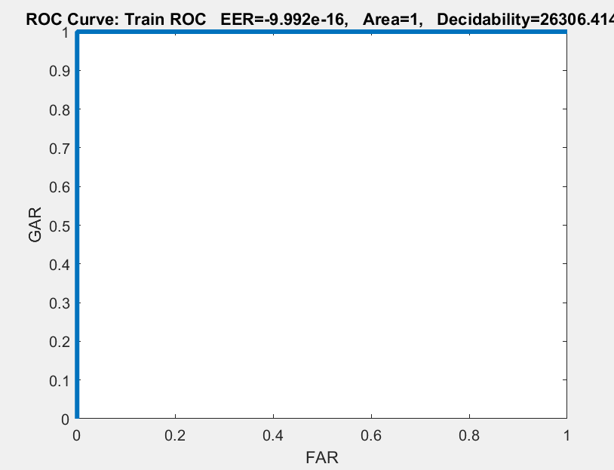
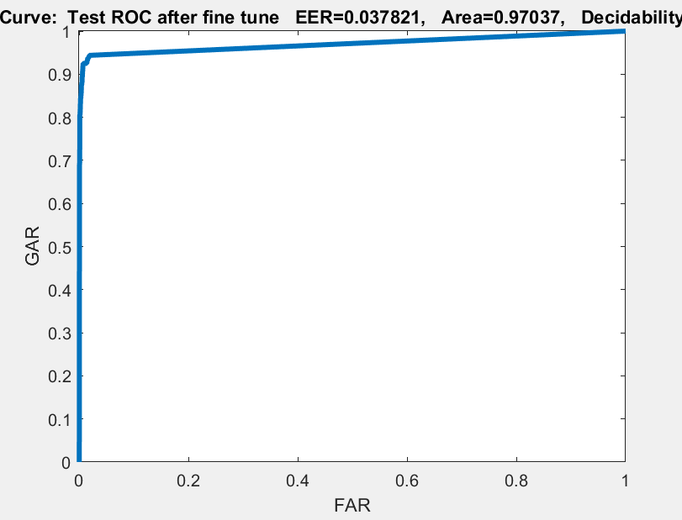
Using soft max layer
Train ROC
H1=400
H2=200
Test ROC
Test ROC after fine-tuning

Slide 14
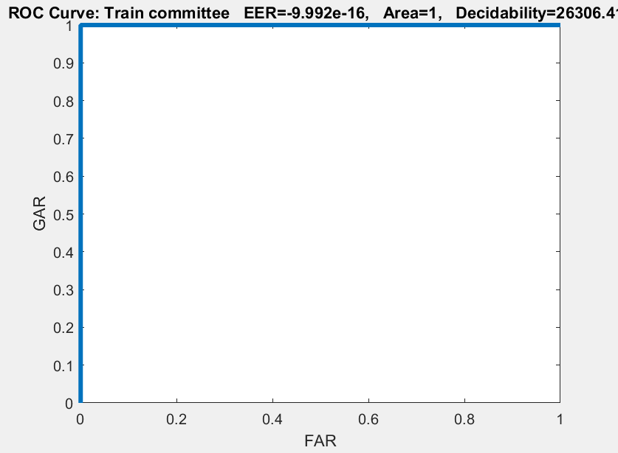
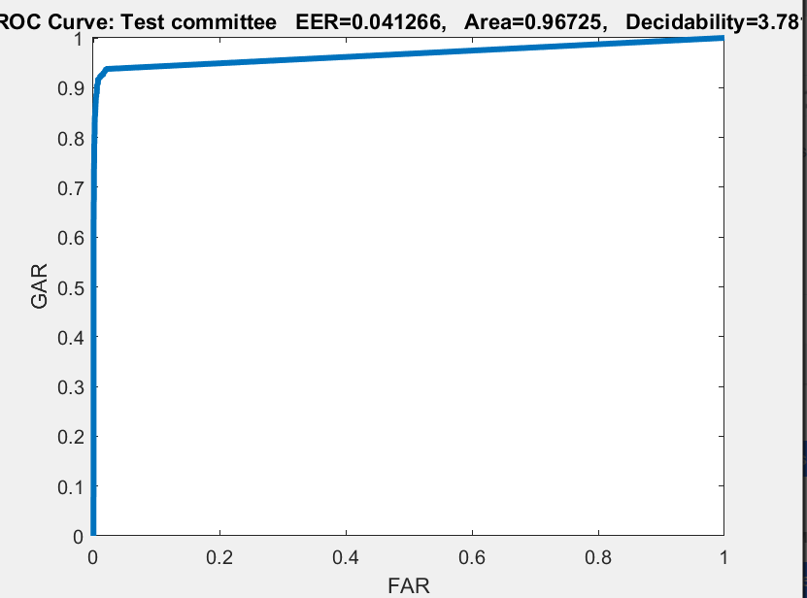
Bonus
Committee of deep neural nets
Best combination
H1=[400,500,400]
H2=[100,200,200]
Train ROC
Test ROC

